Slide 1
ONE PERSON IN GROUP-> CLICK USE TEMPLATE
WHEN THE COPIED TEMPLATE OF THESE SLIDES OPENS IN A NEW TAB:
ADD YOUR Group NAME TO THE TITLE
SHARE WITH GROUP MEMBERS (USE SHARE BUTTON)
COPY THE TITLE AND LINK TO YOUR RECORDS (Digital folder/table of contents)
Remember it is advisable to make a PERSONAL copy and link it when DONE

Slide 2
Introduction to Solutions

Slide 3
ESSENTIAL QUESTIONS
Remember, you should be able to thoroughly answer these AFTER learning through following resources.
What properties could solutes have that allows them to dissolve in solvents?
What the different classes of solutions?
What role does intermolecular forces play in solubility of a solute?

Slide 4
Instructions
Follow through the Engage to Apply resources in order .
Once complete, choose from Extend resources as interested.
Record your learning in these slides- Remember to keep track of where to find these slides for studying!
Complete the Essential Questions Response in the Apply Section.
Try the Extend section and optional Apply practice as desired to deepen your understanding

Slide 5
Hyperdoc Elements
Click for quick access to:
Engage
Explore
Explain
Apply
Extend

Slide 6
Terminology - As you encounter terms new to you, define in your own words here, include examples (make them up!)

Slide 7
Part 1: ENGAGE

Slide 8
Engage - Part A: 5 minutes
In your groups, pick any 3 below. Discuss what you know, and what questions you have.
The terms melting and dissolving have the same meaning
Oil doesn’t mix with water because oil and water molecules repel each other
In a solution, solute is the component present in the smallest quantity
Solutions only refer to liquids
Solubility is affected by temperature and pressure
When diluting acids, water should be ADDED TO the concentrated acid

Slide 9
Engage - Part B: 5 minutes
In your groups,brainstorm 5 reasons solutions are important.
Give as many reasons as you can, whether you think they are correct or not! (don’t self edit!)

Slide 10
Engage - Part C: 5 minutes
In your groups,watch the videos on slide 11 and slide 12. After the second, briefly imagine what that technology will change in the future
(2 mins).

Slide 11
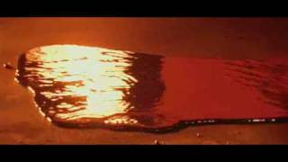
Scene From Terminator: T-1000
Is this Possible?

Slide 12
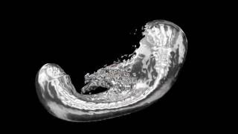

Slide 13
Part 2: EXPLORE

Slide 14

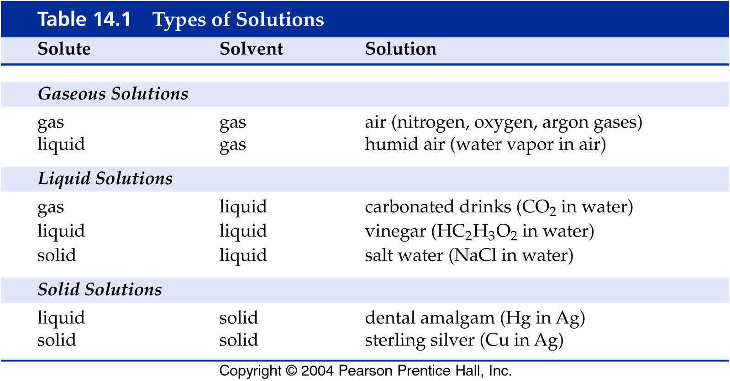
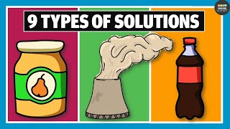
Explore - Classes of Solutions
A solution is made up of a solute (the material that dissolves) and a solvent, (the material that does the dissolving). There are different ways we can form a solution (classes), and it exists in all three states of matter (solid solutions, liquid solutions, gas solutions)

Slide 15
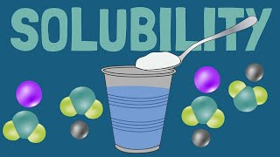
Explore - Polarity
Recall: Determining Solubility
Solubility of a solute in some solvent is
dependent on the intermolecular (IM) forces
within both compounds:
The forces that attract Solute-Solute and Solute-Solvent
Generally, if the IM forces in the solvent are the same (or similar) to those within the solute, we can say the solute is soluble in that solvent
This rule can be summarized as LIKE DISSOLVES LIKE

Slide 16
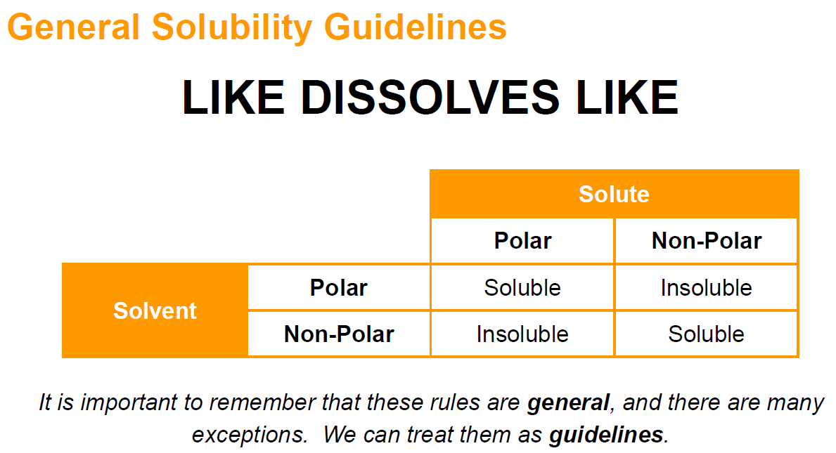
Explore - Polarity

Slide 17
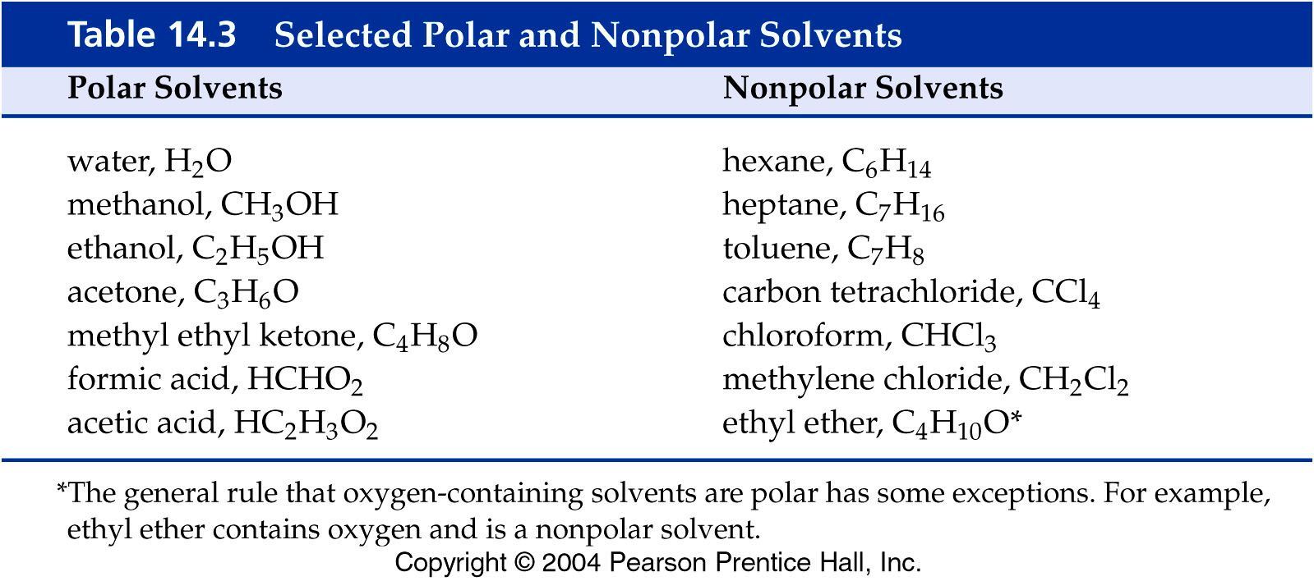
Explore - Polar & Non-Polar Solvents
A liquid composed of polar molecules is a polar solvent. Water and ethanol are polar solvents.
A liquid composed of nonpolar molecules is a nonpolar solvent. Hexane is a nonpolar solvent.
Methanol dissolves in water but hexane does not dissolve in water.
Hexane dissolves in toluene, but water does not dissolve in toluene.

Slide 18
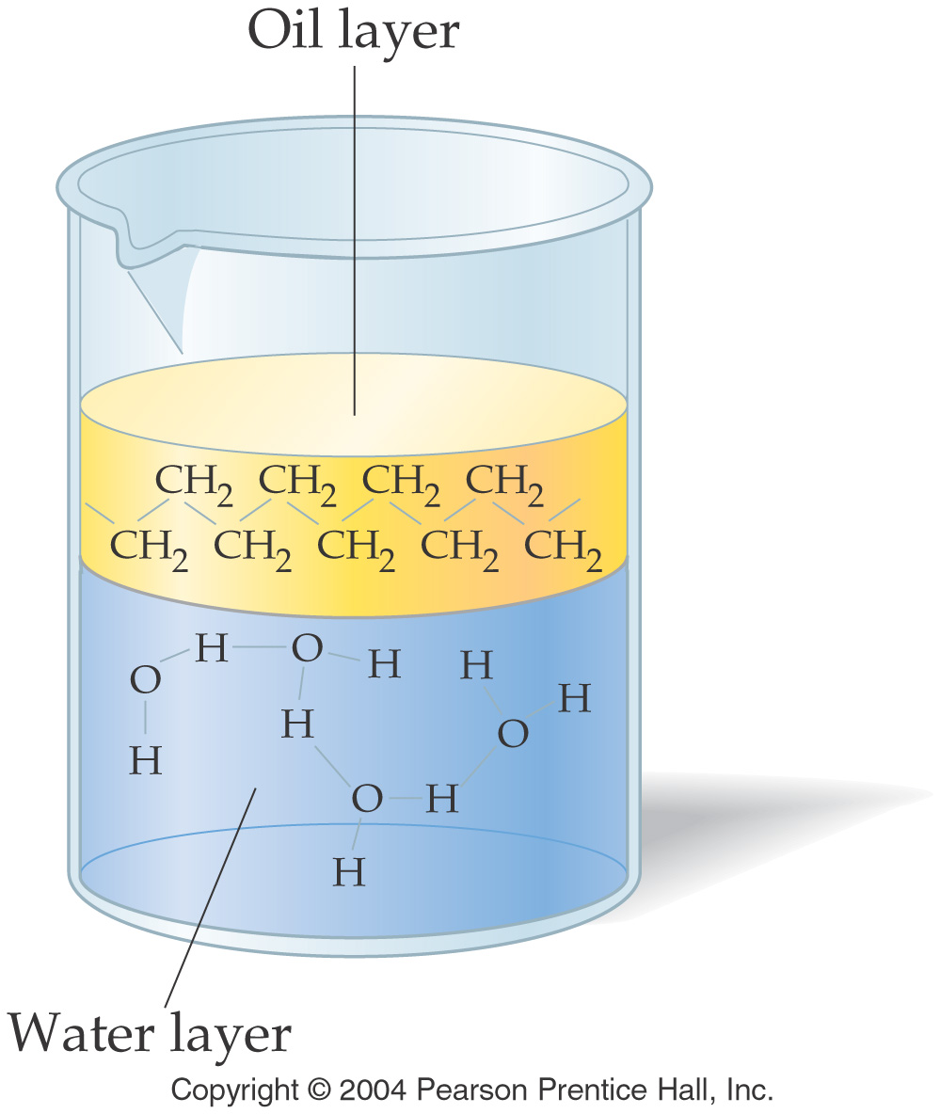
Explore - Miscible & Immiscible
Two liquids that completely dissolve in each other are miscible liquids.
Two liquids that are not miscible in each other are immiscible liquids.
Polar water and nonpolar oil are immiscible liquids and do not mix to form a solution.

Slide 19
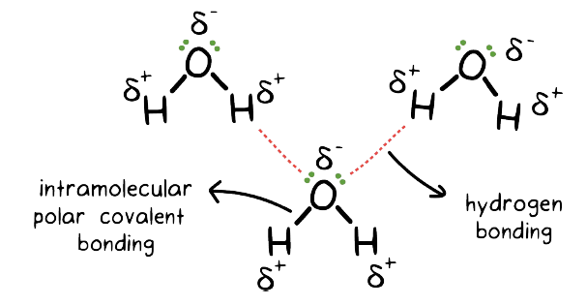
Explore - Solids in Solution
When a solid substance dissolves in a liquid, the solute particles are attracted to the solvent particles.
When a solution forms, the solute particles are more strongly attracted to the solvent particles than other solute particles.
We can also predict whether a solid will dissolve in a liquid by applying the like dissolves like rule.

Slide 20
Explore - Solubility of Ionic Compounds
Ionic compounds, like sodium chloride, are soluble in polar solvents and insoluble in nonpolar solvents.
Polar compounds, like table sugar (C₁₂H₂₂O₁₁), are soluble in polar solvents (dipole and H-bond attractions) and insoluble in nonpolar solvents.
Nonpolar compounds, like naphthalene (C₁₀H₈), are soluble in nonpolar solvents and insoluble in polar solvents. LDF allow non-polars to attract and mix but cannot disrupt stronger dipole attractions

Slide 21
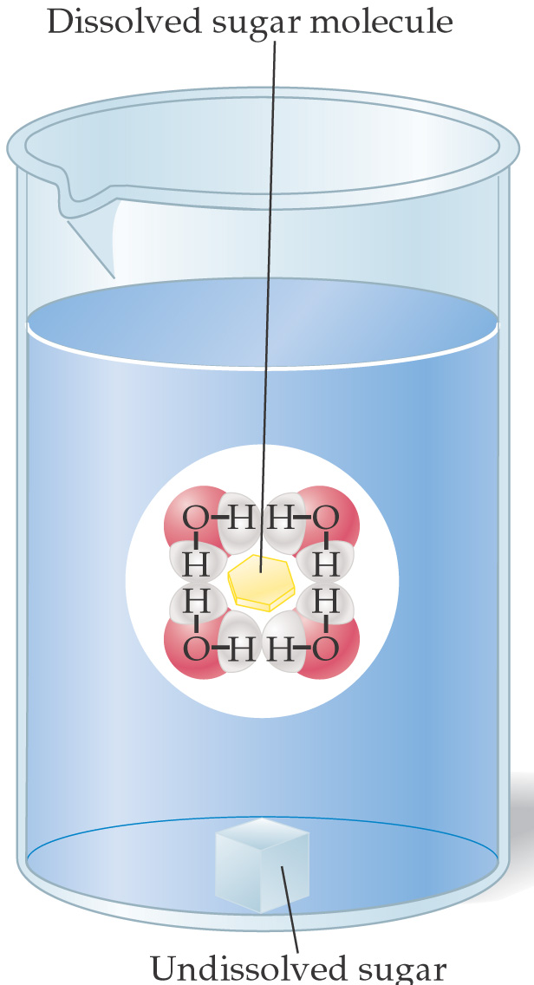
Explore - Dissolving Process
When a soluble crystal is placed into a solvent, it begins to dissolve.
When a sugar crystal is placed in water, the water molecules attack the crystal and begin pulling part of it away and into solution.
The sugar molecules are held within a cluster of water molecules called a solvent cage.

Slide 22
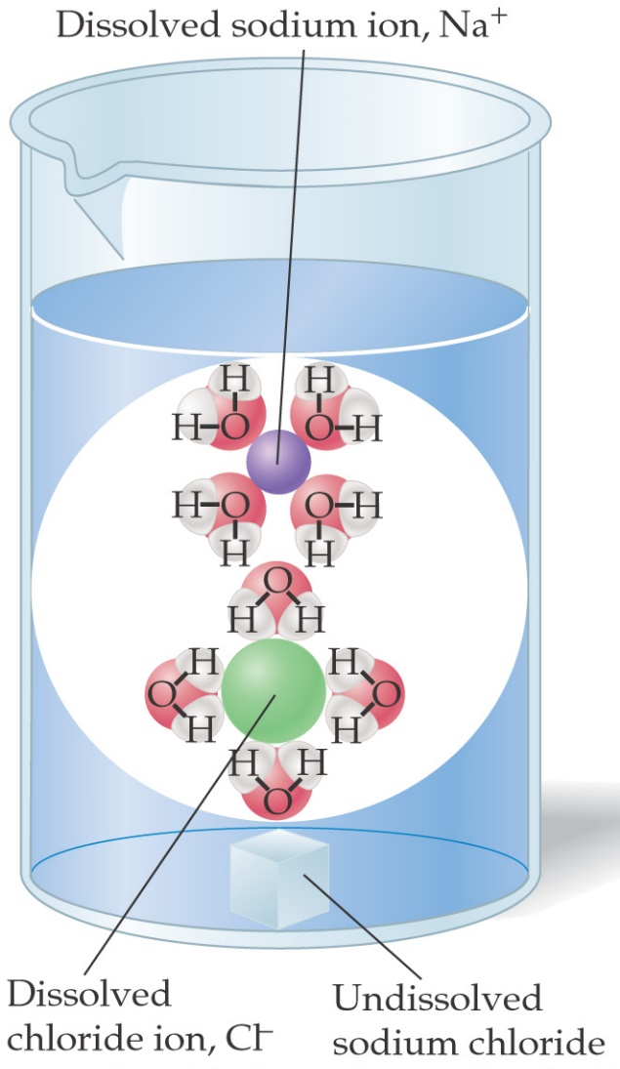
Explore - Dissolving Process
When a sodium chloride crystal is place in water, the water molecules attack the edge of the crystal.
In an ionic compound, the water molecules pull individual ions off of the crystal.
The anions are surrounded by the positively charged hydrogens on water.
The cations are surrounded by the negatively charged oxygen on water.

Slide 23
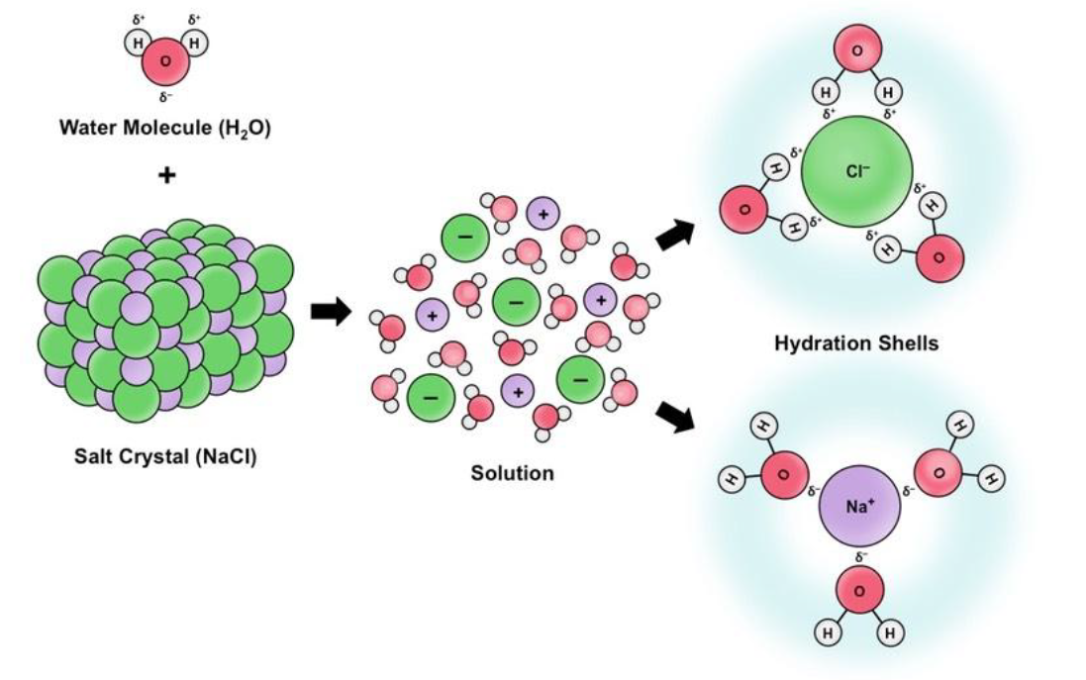
Explore - Dissolving Process

Slide 24

Explore - Dissolving
IN YOUR GROUP - WORK AT A CLASS WHITEBOARD
Record your work (take a photo and insert in these slides, redraw it in your notes etc)
Draw a three NaCl formula units, showing the ion charges (3 Na ions with three Cl ions,a small crystal!)
Draw a water molecule, showing its bent shape and polarity of the bond(δ+ or δ+)
Draw what will happen when NaCl is put into the water (THINK - use your knowledge of intermolecular forces and attraction)
Show your teacher & record!
Replace the NaCl with NH₃ and repeat Step 3 &4. Draw the shape and polarity of NH₃!

Slide 25
Explore - Dissolving
Slide to insert images of your board work

Slide 26
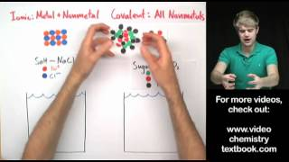
Explore - Dissolving
{Optional} For further help you can watch this video

Slide 27
Part 3: Apply

Slide 28
Apply- As a group at the Boards
Create a mindmap with labelled interconnections using the terms and concepts you have learned. Make sure it shows a good understanding of how the different intermolecular forces affect solubility.
Ensure you take a picture and insert on the next slide
Discuss your map with your teacher!

Slide 29
Apply: Your map

Slide 30
Apply - Complete this chart
Substance A | Substance B | Miscible or Immiscible? | Identify the solvent | State of final solution (s, l, g)
1L H₂O_{(l)} | 1 g KCl_{(s)}
10 ml H₂O_{(l)} | 100 ml alcohol CH₃OH_{(l)}
1 ml C₆H_{14 (l)} | 1000 ml H₂O_{(l)}
5 gm gelatin (think jello!) | 500 ml H₂O_{(l)}
1 ml H₂O _{(g)} | 1 x 10⁶ L N₂ _{(g)}
100 g Cu_{(s)} | 10 g Zn_{(s)}

Slide 31
Next slide(s) provide answers to activities

Slide 32
Apply - Complete this chart
Substance A | Substance B | Miscible or Immiscible? | Identify the solvent | State of final solution (s, l, g)
1L H₂O_{(l)} | 1 g KCl_{(s)} | Miscible | H2O_{(l)} | Liquid
10 ml H₂O_{(l)} | 100 ml alcohol CH₃OH_{(l)} | Miscible | CH3OH_{(l)} | Liquid
1 ml C₆H_{14 (l)} | 1000 ml H₂O_{(l)} | Immiscible | None | N/A
5 gm gelatin (think jello!) | 500 ml H₂O_{(l)} | Miscible | H₂O_{(l)} | Solid
1 ml H₂O _{(g)} | 1 x 10⁶ L N₂ _{(g)} | Miscible | N₂ _{(g)} | Gas
100 g Cu_{(s)} | 10 g Zn_{(s)} | Miscible | Cu_{(s)} | Solid

Slide 33
Part 5: Beyond the course extensions
{optional - none avail currently}

Slide 34

The Future of 3D printing with Solutions (10 mins)

